Slide 1
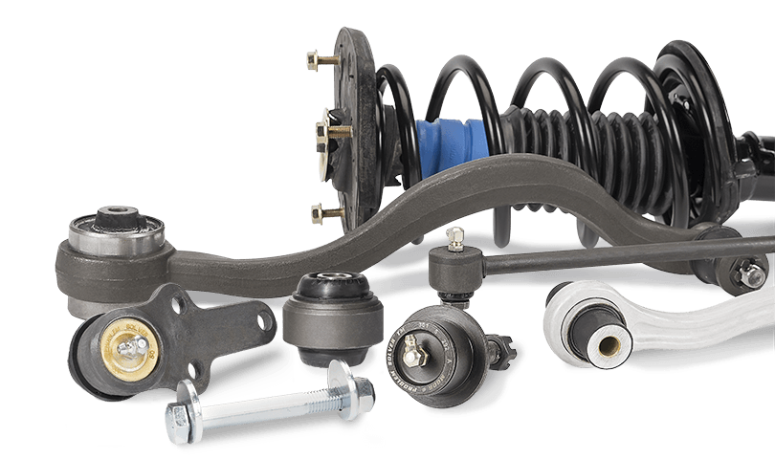
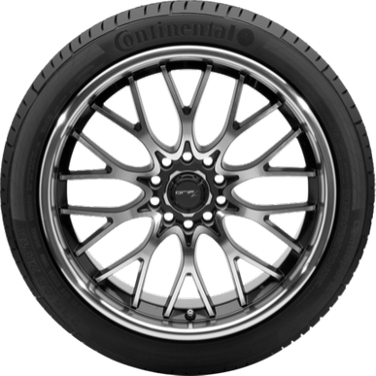
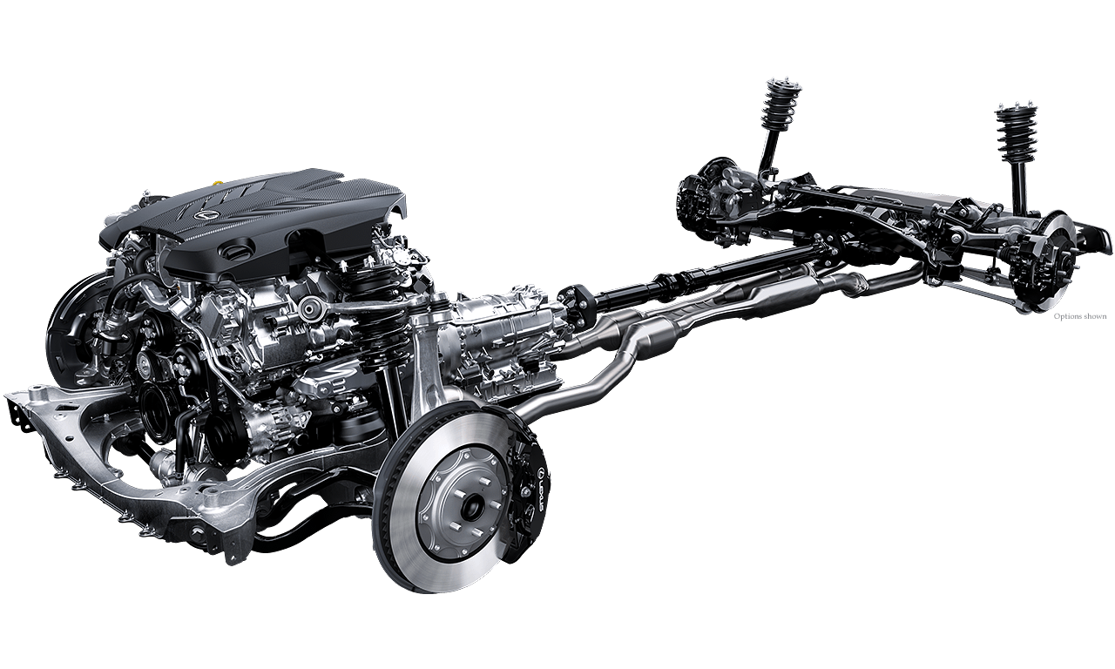
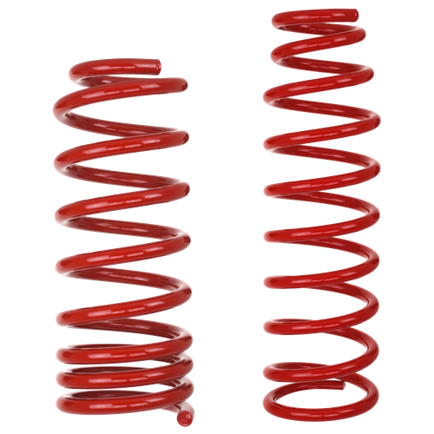
C&C
Constructing and customizing
U1810265, Jonibek Mansurov(Group#2)
U1810281, Amir Djanibekov (Group#2)
U1810256, Alisher Khasanov (Group#2)
U1810270, Aleksandr Sim (Group#2)
U1810274, Artyom Lee (Group#2)

Slide 2
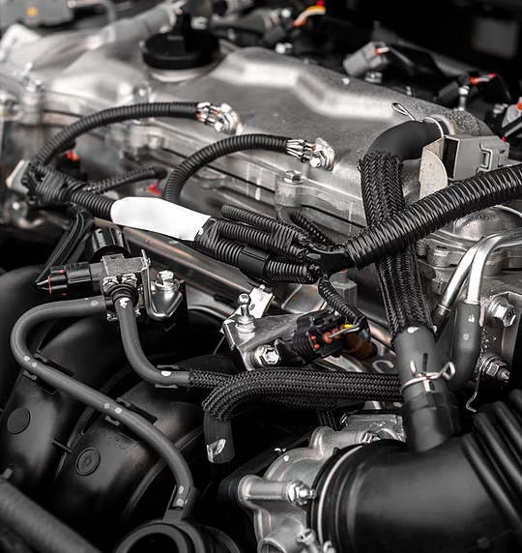
Presentation Outline
Key topics for discussion
Introduction
Benefits
Services

Slide 3
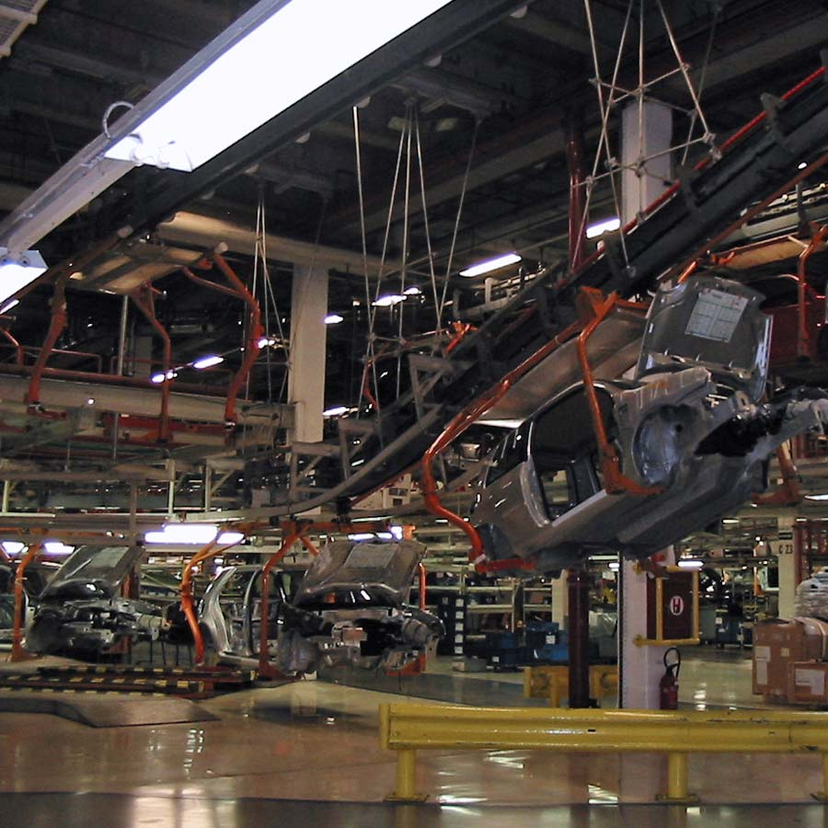
Car conveyor system
Automatizated
"Automatizated process may be implemented not only in entirely constructing new cars but also partly."

Slide 4
Quality
No random errors
Speed
Benefits
No lines and weekends in process
Automized
There is no need in lunch break and vocations

Slide 5

GRAPH ILLUSTRATION
F
B
D
H
A
C
G
E

Slide 6
SINGLE LINKED LISTS ILLUSTRATION
H
F
G
F
A
D
G
A
A
B
C
B
D
C
D
E
D

Slide 7
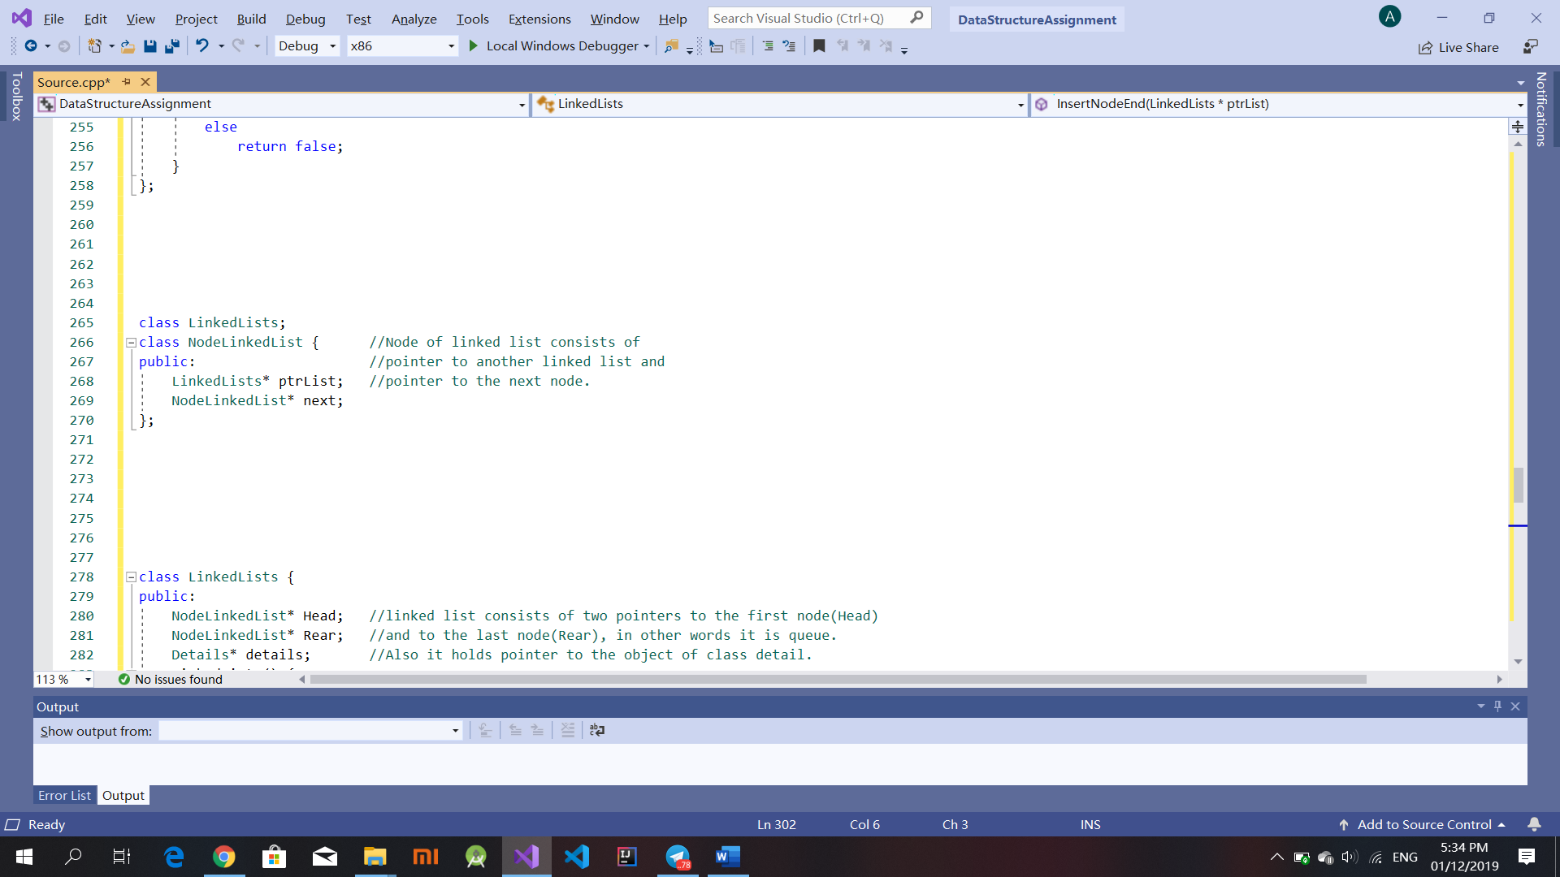
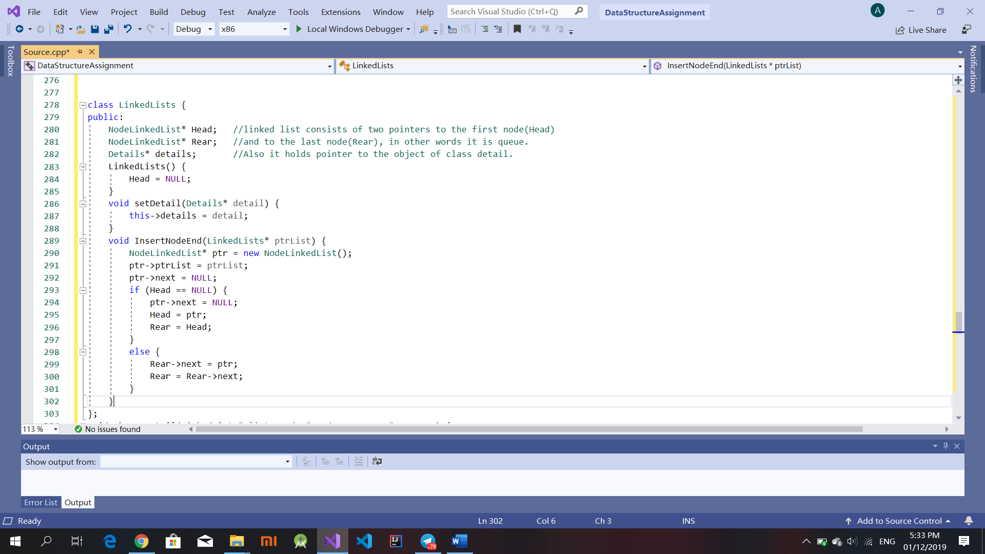

Slide 8
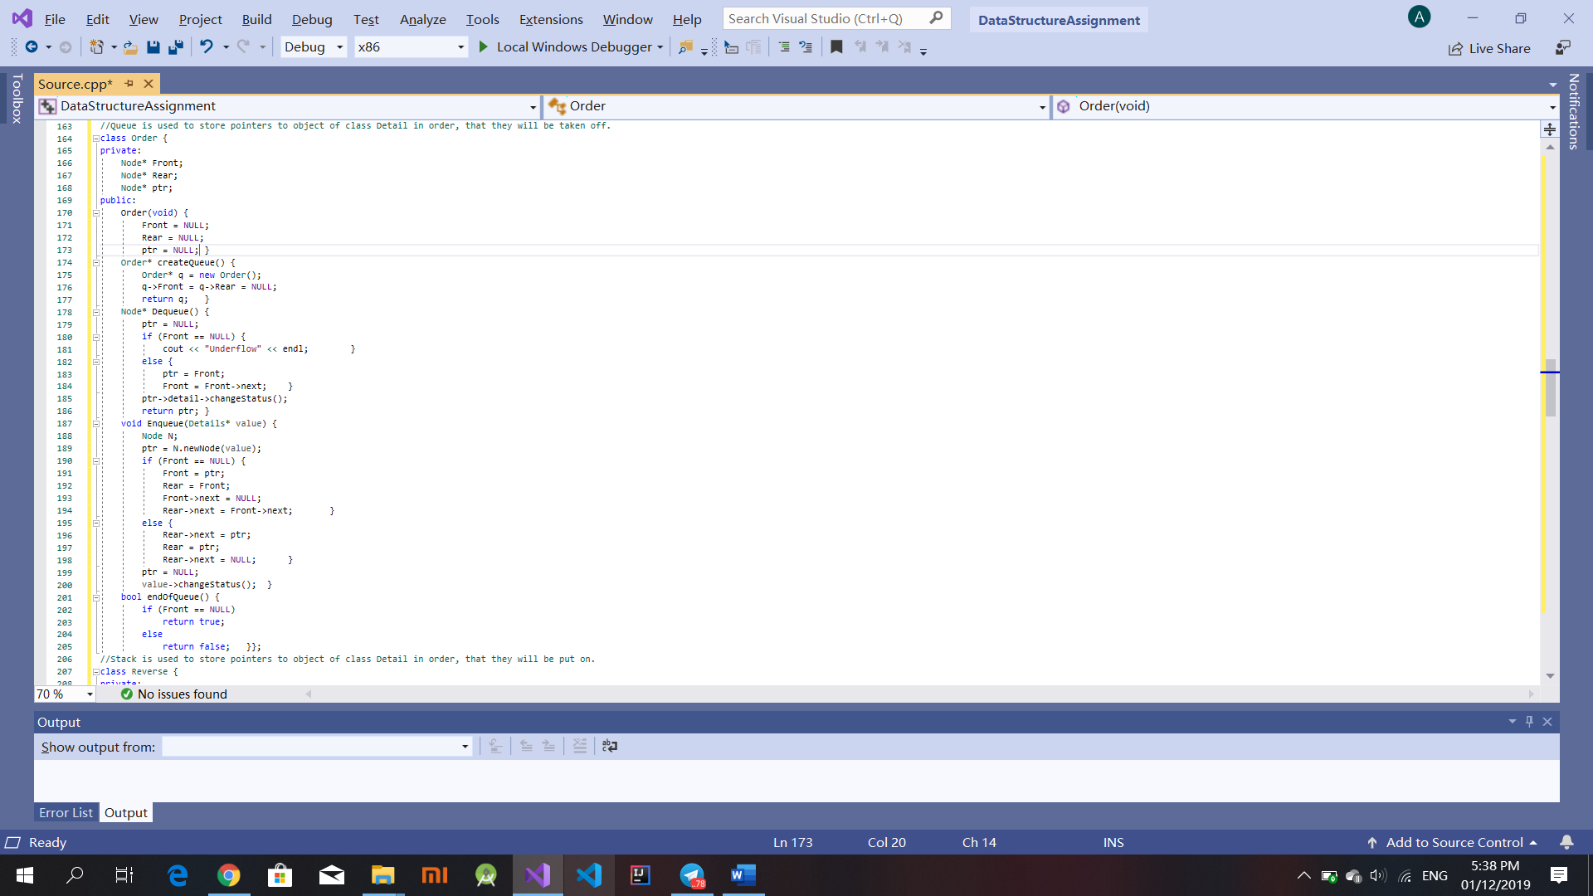
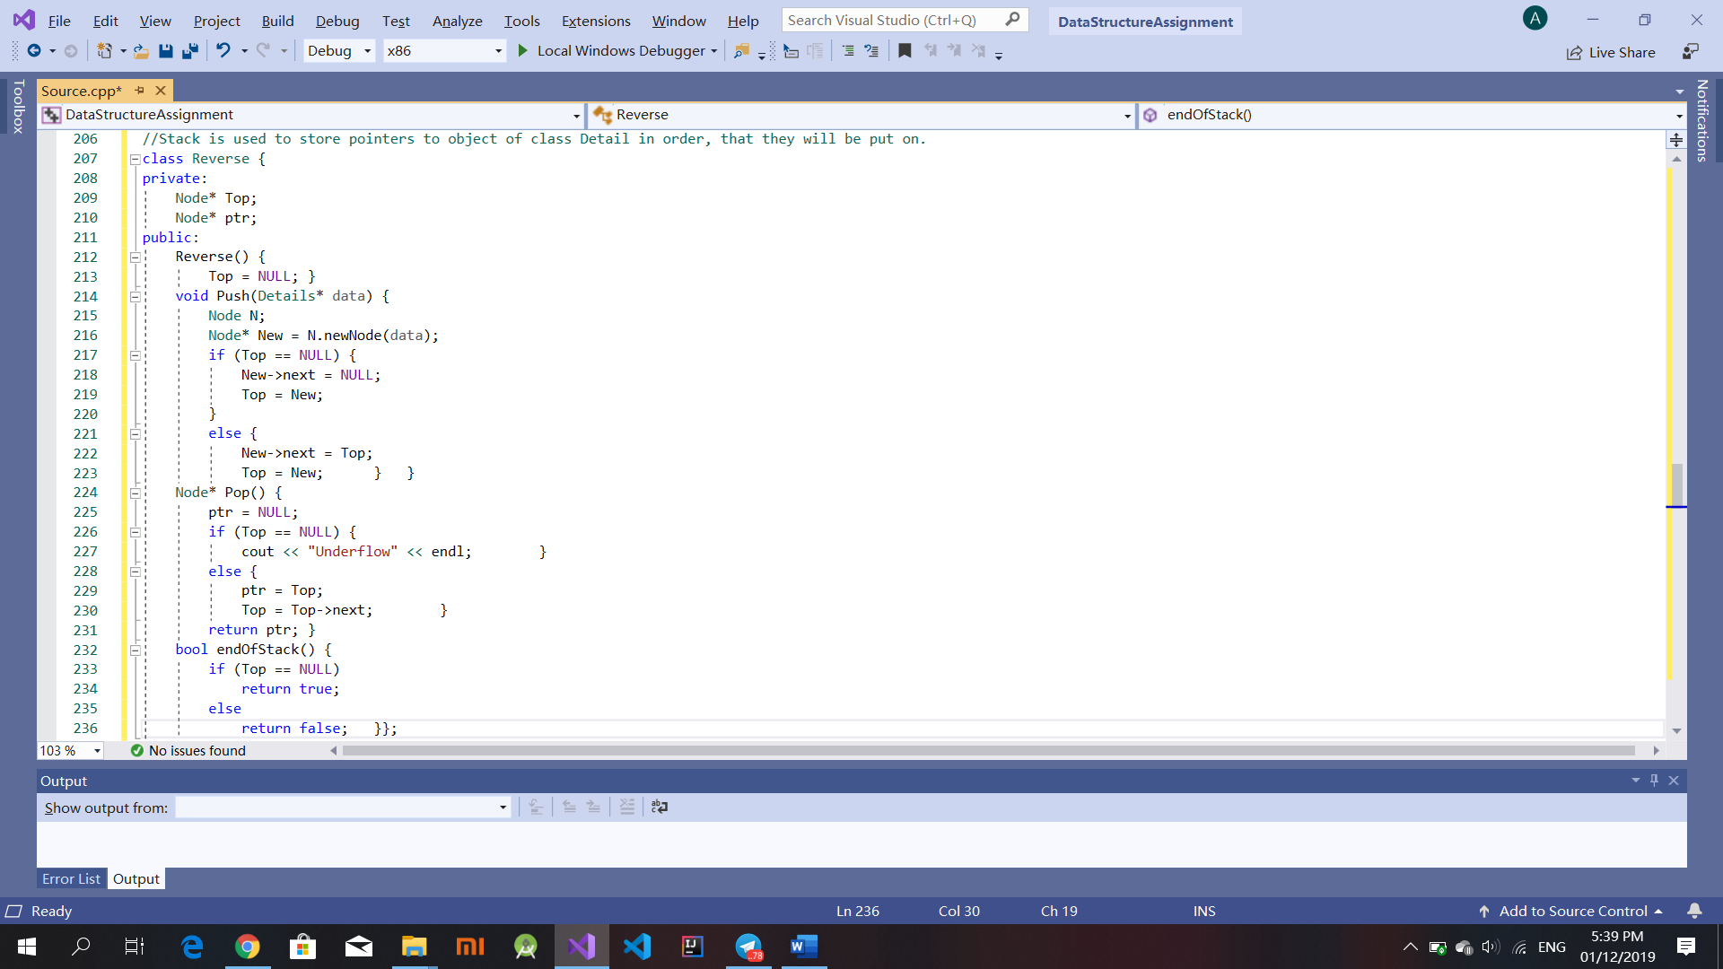

Slide 9
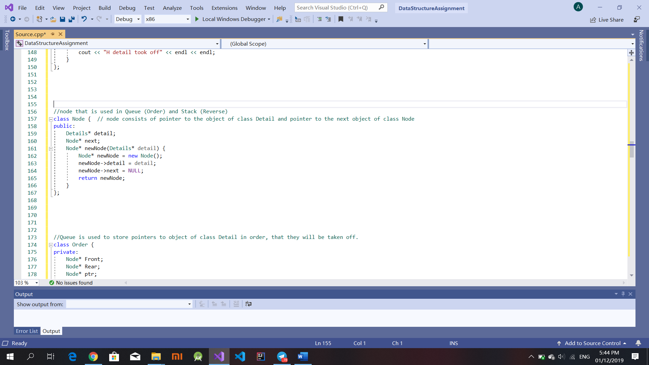
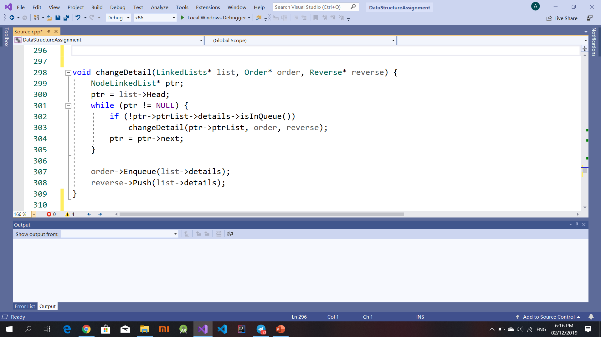

Slide 10
For your attention thank you.

